Slide 1
CPU Scheduling Lesson 5 Linux Scheduling
David Liu
Fall 2021, Spring 2022

Slide 2
Linux Scheduling Through Version 2.5
Prior to kernel version 2.5, ran variation of standard UNIX scheduling algorithm
Version 2.5 moved to constant order O(1) scheduling time
Preemptive, priority based
Two priority ranges: time-sharing and real-time
Real-time range from 0 to 99 and nice value from 100 to 140
Map into global priority with numerically lower values indicating higher priority
Higher priority gets larger q
Task run-able as long as time left in time slice (active)
If no time left (expired), not run-able until all other tasks use their slices
All run-able tasks tracked in per-CPU runqueue data structure
Two priority arrays (active, expired)
Tasks indexed by priority
When no more active, arrays are exchanged
Worked well, but poor response times for interactive processes

Slide 3
Linux Scheduling Classes
Completely Fair Scheduler (CFS)
Scheduling classes
Each has specific priority
Scheduler picks highest priority task in highest scheduling class
2 scheduling classes included, others can be added
default
real-time

Slide 4
Linux Scheduling Time Slices
Time Slice for each task
based on nice value from -20 to +19, Lower value is higher priority
Calculates target latency – interval of time during which task should run at least once
Target latency can increase if say number of active tasks increases
Proportion CPU time are allocated from the value fo target latency
Default and minimum value

Slide 5
Linux Scheduling Task Selection
CFS does not directly assign priorities
CFS scheduler maintains per task virtual run time in variable vruntime
Associated with decay factor based on priority of task – lower priority is higher decay rate
Normal default priority yields virtual run time = actual run time
To decide next task to run, scheduler picks task with lowest virtual run time
High priority actual time =100, vrt = 20
Normal P actual time = 80 vrt = 80
Low P actual = 45, vrt = 90

Slide 6
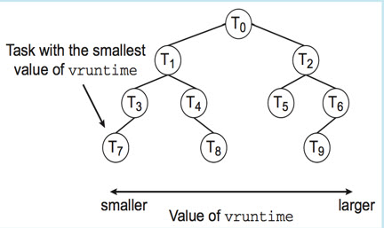
Linux Scheduler Balanced Binary Tree
Cache the smallest vruntime
What is the time complexity
In Big O?

Slide 7
Linux Virtual Run time
Virtual run time
How long each task has run
Decay factor: lower priority is higher decay rate
Physical run time: 200 ms
Normal priority: 200 ms virtual run time
Lower priority: > 200 ms virtual run time
higher priority: < 200 ms virtual run time
scheduler picks task with lowest virtual run time

Slide 8
I/O-bound vs CPU-bound Tasks
The same nice values
Value of vruntime will eventually be lower for the I/O-bound task
Often I/O-bound preempts the CPU-bound

Slide 9
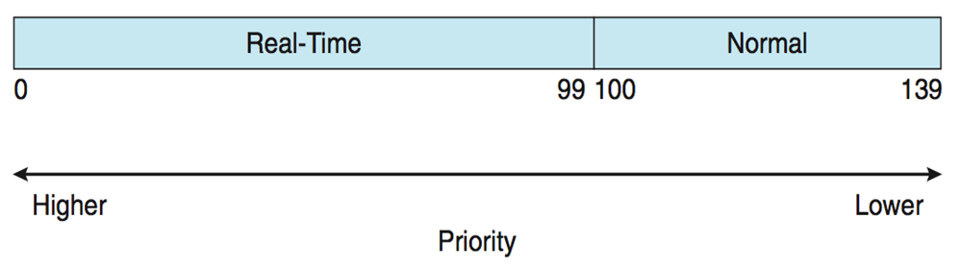
Linux Task Priorities
Real-time tasks have static priorities
Normal task:
Nice value of -20 maps to global priority 100
Nice value of +19 maps to priority 139

Slide 10
Linux Load Balance Support
Load based on
task’s priority
average CPU utilization
Goal: all queues have approximately the same load
Priority | CPU Utilization | Load
high | Low (I/O bounded) | low
low | High (CPU bounded) | low

Slide 11
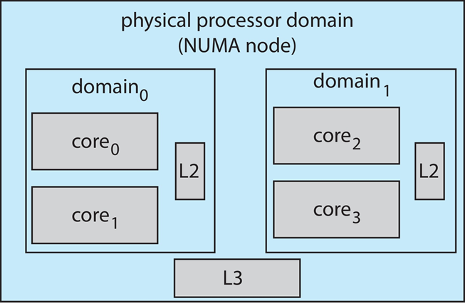
Minimize Migration Cost
Scheduling domain is a set of CPU cores that can be balanced against one another.
Domains are organized by what they share (i.e. cache memory.)
Hierarchical scheduling domains
Goal: keep threads from migrating between domains.

Slide 12

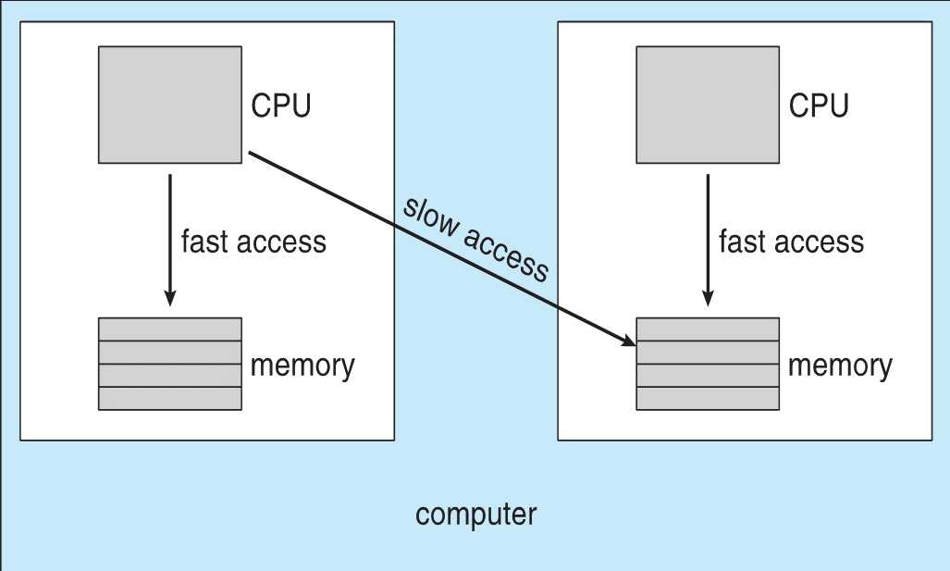
Scheduling Domain Hierarchy
Overall busy system, load-balance limited on the domain local to the core.

Slide 13
Little’s Formula
n = average queue length
W = average waiting time in queue
λ = average arrival rate into queue
Little’s law – in steady state, processes leaving queue must equal processes arriving, thus: n = λ x W
Valid for any scheduling algorithm and arrival distribution
For example, if on average 7 processes arrive per second, and normally 14 processes in queue, then average wait time per process = 2 seconds

